Slide 1


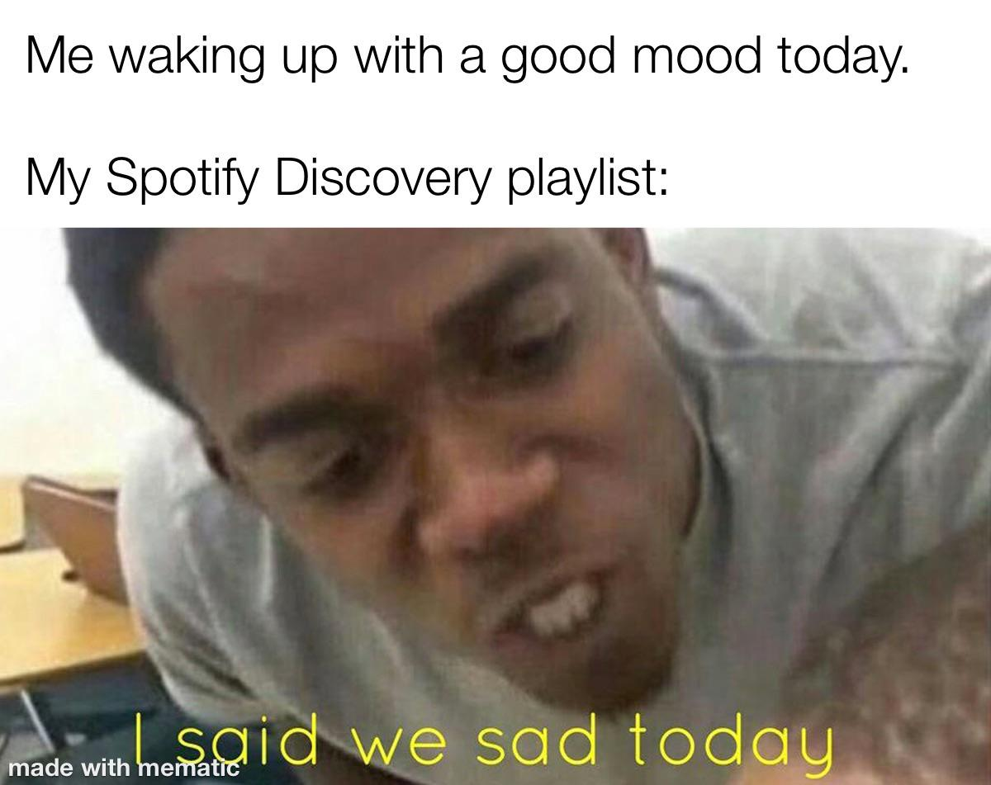
Predicting
Popularity on
Philip Peker
DATR-406, General Assembly
June 2021

Slide 2

Agenda
Intro
Research Question
Data Sources
The ML Journey
EDA
Modeling
Results
Limitations and Next Steps
Conclusions

Slide 3
Intro

Slide 4
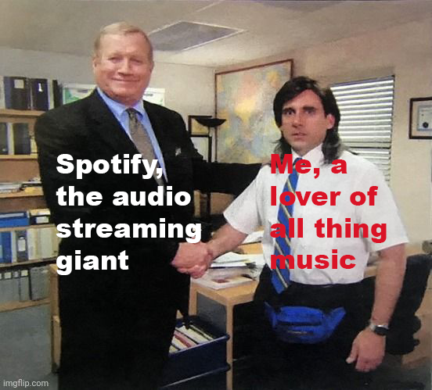
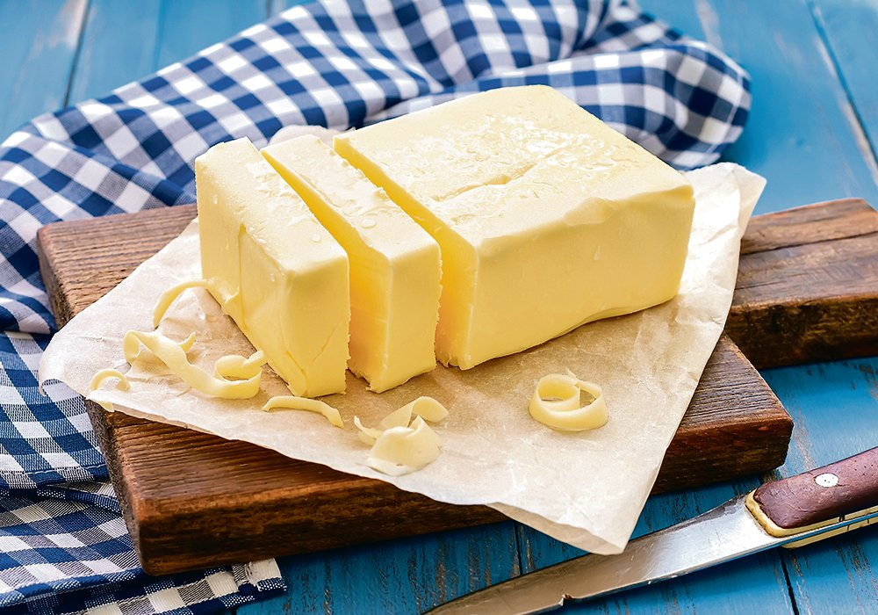
The Who?
Notes:
Spotify is the world’s biggest audio streaming platform, by number of subscribers. This also means it has the world’s largest data bank on everything streaming: how users listen, how recording artists publish, and codifying what makes one song different from another
Therefore, Spotify has the unique responsibility of determining how to ensure the “game” works for both listeners and makers (including the artists, the labels, the publishers etc)
The levers that Spotify pulls to keep the game “fair” (whether the Spotify game is fair is hotly debated) is largely in the form of data. The platform it provides for both sides of the ecosystem is ruled by the signals it gets from its users and artists, and those signals are based on prior data, and so on

Slide 5
Research Question

Slide 6
The What?
I was specifically interested in finding out a bit more on how Spotify understands the “popularity” of a track. Could we use a tracks attributes to predict the track’s popularity?
Sub-questions and goals:
Which track attributes are considered the strongest indicators of popularity?
How high of a correlation can we reasonably achieve?
Understanding how Spotify decomposes tracks by attributes and why

Slide 7
Setting Expectations
While music as a language and a pedagogy is quantifiable (music theory), music as a form of expression is massively subjective and qualitative in nature
If we were to discover a robust and generalized algorithm for predicting song popularity based on track attributes, this would mean musicians could reverse engineer it and build a song that will surely be popular.
Ultimately, I wanted to see how far I can push ML techniques to find as strong of a correlation between certain track attributes and popularity

Slide 8
Data Sources

Slide 9
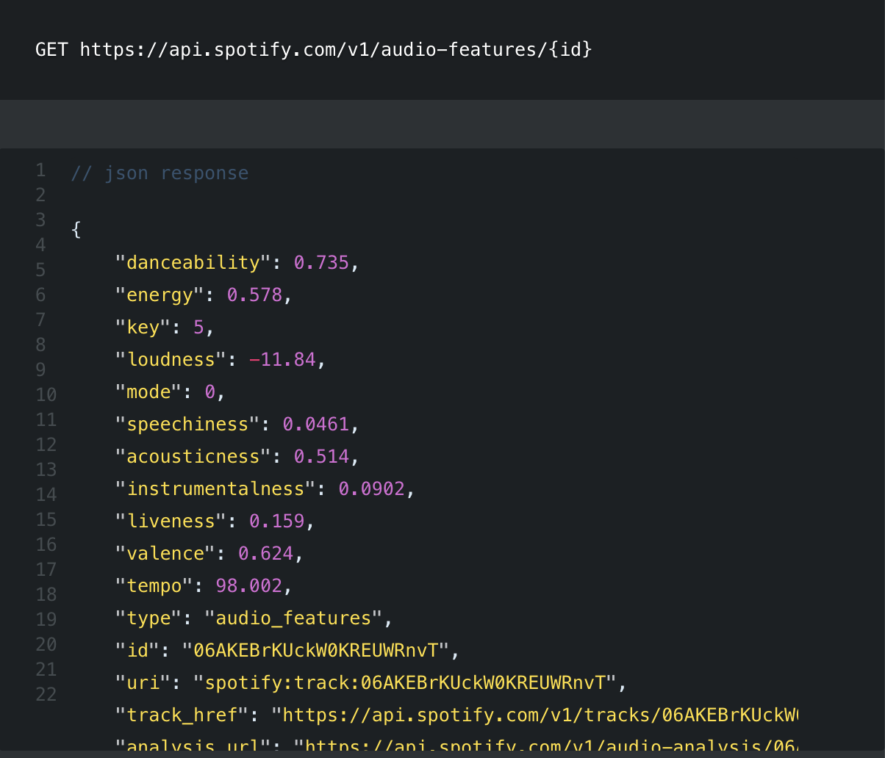
The Web API
Spotify has a public web API that gives developers access to a (*small, not sure how small) portion of their datasets
In this Web API, Spotify reveals callable parameters that can be used to analyze tracks on their platform. For example, each track is parametrized by “danceability”, “key”, “mode”, “energy”, “valence”

Slide 10
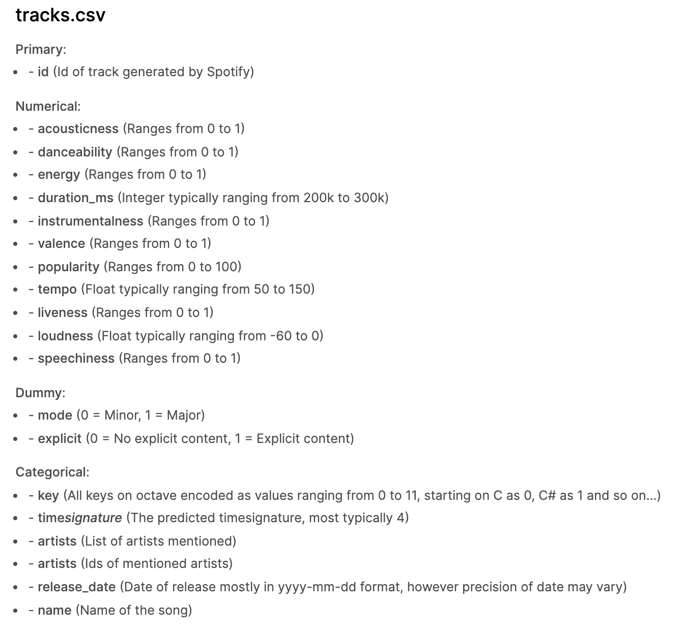
The Data Source
https://www.kaggle.com/yamaerenay/spotify-dataset-19212020-160k-tracks?select=tracks.csv
586,672 rows, 20 columns
Watchouts
2 variables already dummified
Certain variables are value-encoded, like ‘key’, but their relative values are meaningless
‘timesignature’ is actually a predicted value already

Slide 11
The ML Journey

Slide 12
ML Approach
Scoping
Data Wrangling
Exploring and
Cleaning
Modeling
Analyzing

Slide 13
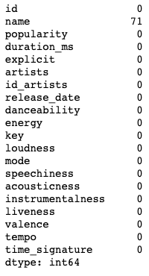
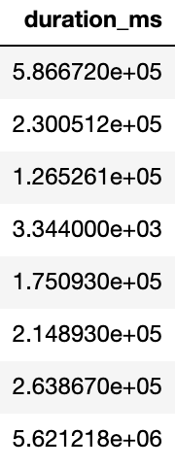
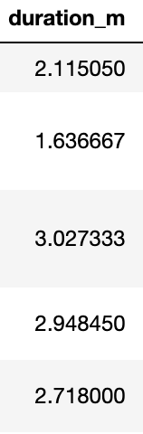
EDA - Some Cleaning
Dropping Nan values
Duration Conversions
Milliseconds → minutes

Slide 14
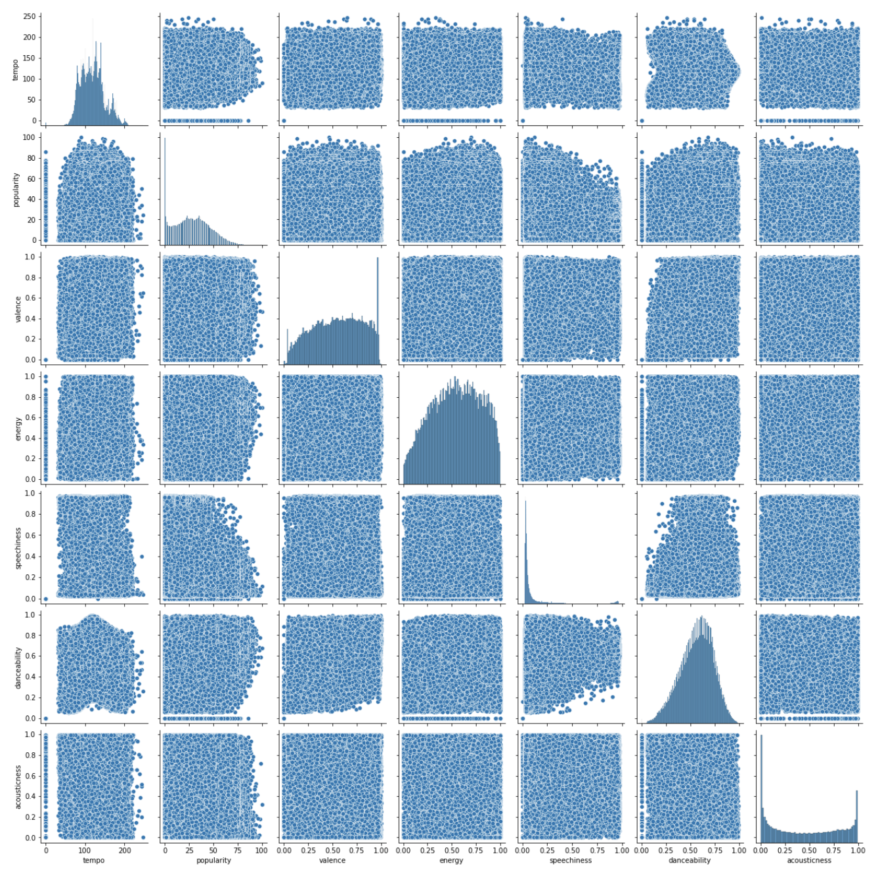
EDA - Visualizations 1
Shockingly little relationships within our dataset...

Slide 15
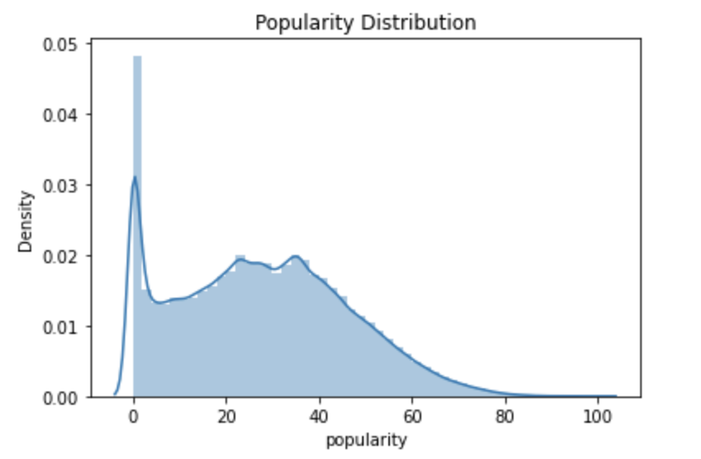
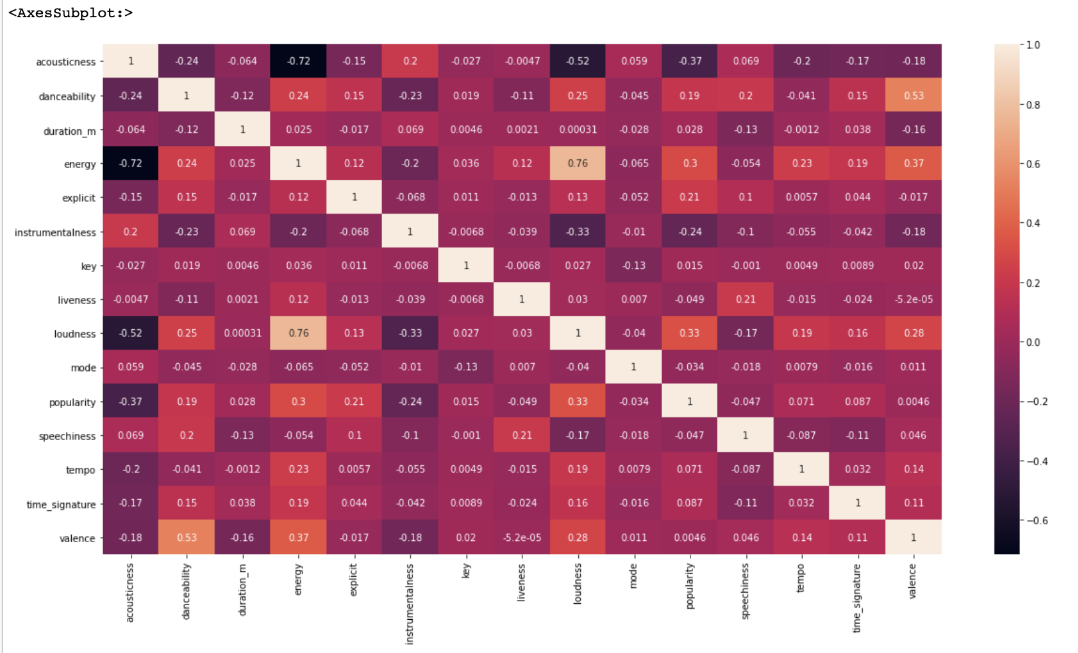
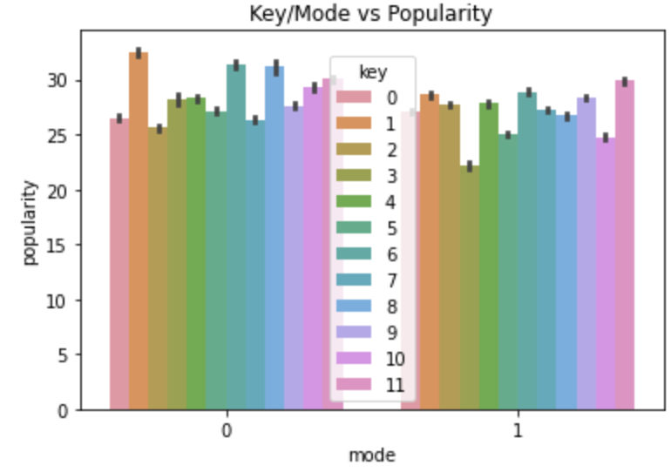
EDA - Visualizations 2
Annotated heatmap
Top Features: acousticness, loudness, instrumentalness, energy
Notes:
Reminder: my hypothesis: can we predict a song's popularity based on certain features of the song?
a few things stand out:
Acousticness
Instrumentalness
Loudness
energy

Slide 16
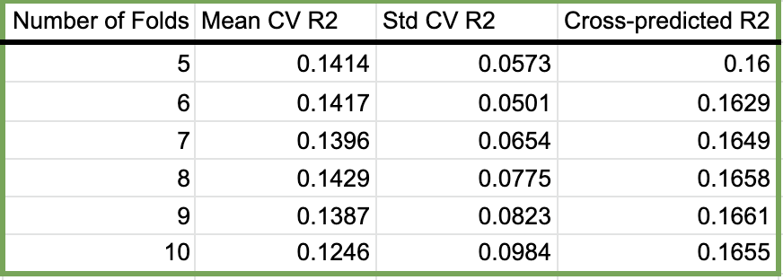
Modeling - Dipping our toes
Dummifying: ‘key’, ‘mode’, ‘time signature’
Starting off with some simple linregs… A poor model fit with a max cross-predicted R2 of .166

Slide 17
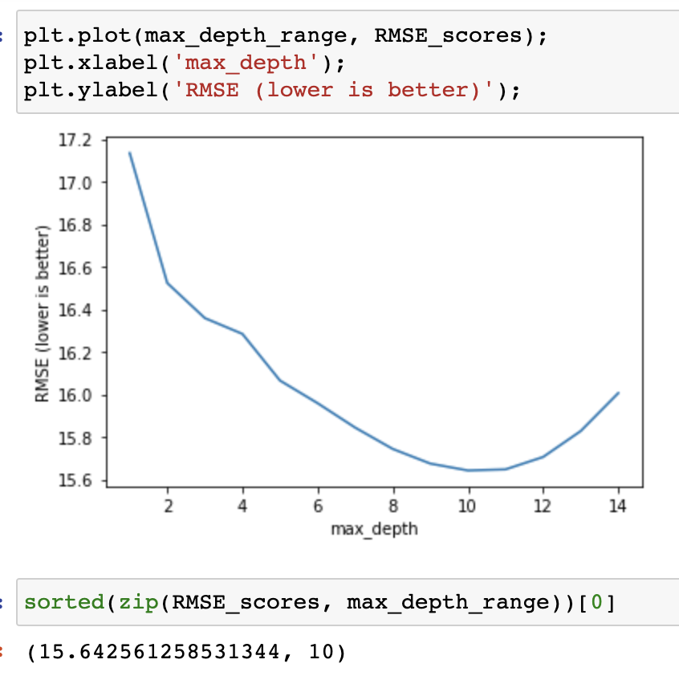
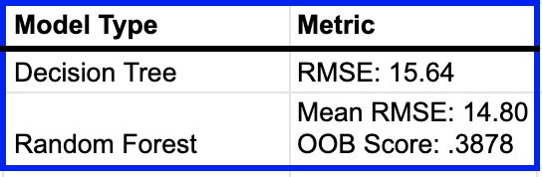
Modeling - Trees, Forests...Fruit?
We tried a decision tree regressor model, and then a random forest model
Even with feature importance extraction, these models were not giving us the heuerist values desired
Decision Tree ain’t cutting it

Slide 18
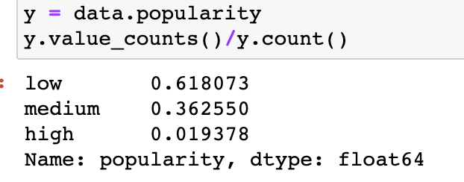
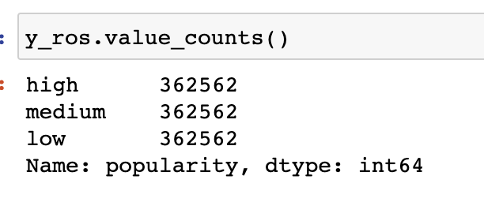
Modeling - Classification
First we tried 4 classes: ‘low’, ‘medium’, ‘high’, ‘super high’
Model was not able to predict ‘super high’ at all, so we binned by 3 classes: ‘low’, ‘med’, ‘high’
We also balanced classes via Imbalanced learn library
Because KNNs are sensitive to scale and irrelevant features, we used standard scaler and feature engineered to include only the most important features in our x
Acousticness
Loudness
Instrumentalness
Energy
Accuracy score of .9915??
Overfitting??

Slide 19
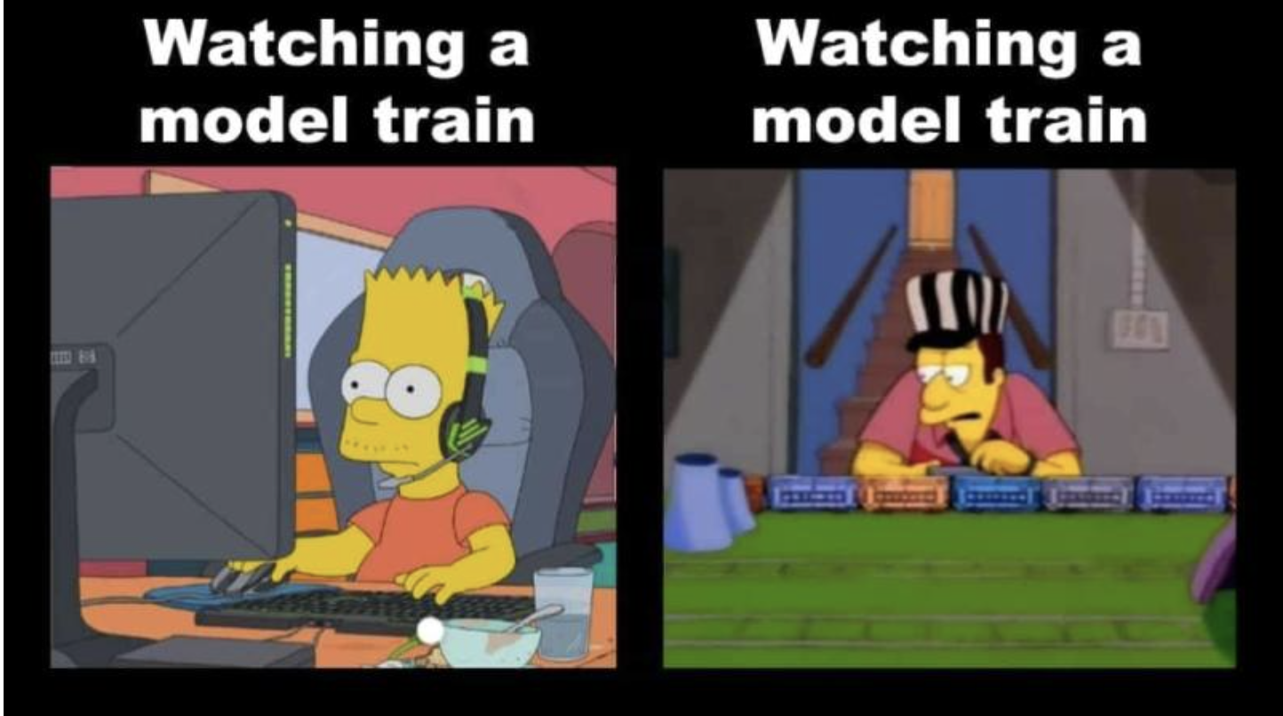
Modeling - Hyperparameter tuning
Train, test, split with test_size = .3
To tune further, we wanted to find an optimal K value
For loops 😫
Grid Search also 😫
Random Search 😎
Best n_neighbors = 3

Slide 20
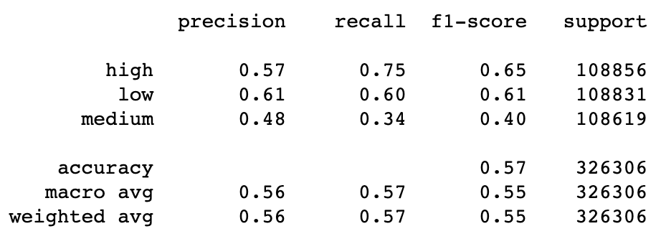
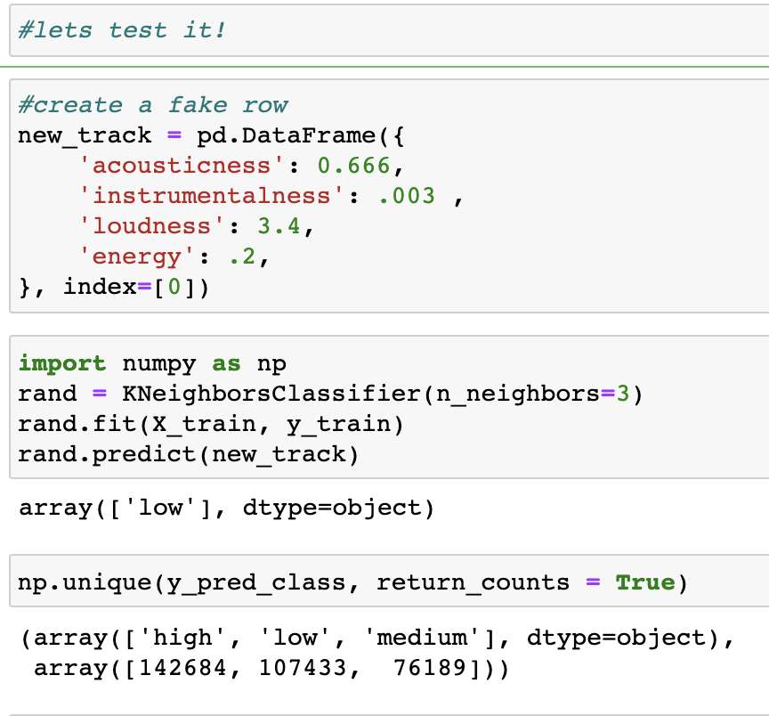
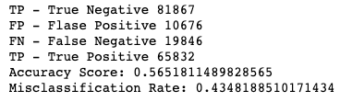
Results
Classification Report
Testing the model
Confusion Matrix

Slide 21
Limitations and Next Steps
Computationally 🤑
For loops, Grid search and fit functions took forever
Only use cv=5, not industry standard of cv=10
Data Balance
A KNN mandate
Oversampling ✅ , Undersampling ❌
Weighted Voting
Time
There is likely still lots of hidden noise in the current data that we did not discover
Trying stacking methods, neural nets, unsupervised learning, etc
Further hyper-parameter tuning
Dataset philosophy

Slide 22
Extensions
Create a popularity predictor web app
New artists can upload their song recent Spotify track.
We will find the song by it’s ID on Spotify and predict it’s popularity via our model
Artists can see (with varying level of accuracy, of course) whether their song will fare well on Spotify
Use as a studio consulting tool, wherein we can help artists find the right level of “acousticness” or “energy”, assuming they want to achieve popularity on Spotify

Slide 23
Conclusions

Slide 24

Zooming and Popping Out
with everyone’s favorite, Olivia Rodrigo

Slide 25
Final Thoughts
To no one’s surprise, predicting the next hit song by granularizing it per its features is no easy task
Results specific to data set
What if we didn’t care about acousticness, loudness, etc. Why are those deemed useful in the first place?
What if we included Twitter/Instagram followers of artist, a metric to represent their current network value, if they’re signed to a label or not (and which one) etc
Spotify, like all guardians of a galaxy, keep certain data hidden, and certain mechanisms undisclosed, to ensure a competitive advantage
PII
Stakeholder permission
One sided dataset, self-serving
Serves Spotify more than the artist in that the attributes are descriptive vs prescriptive

Slide 26
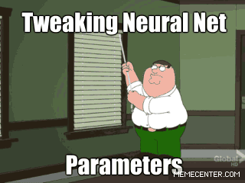
Acknowledgements
Greg for being a patient, unwavering, and incredibly informative teacher
Jordan for letting me pester him non-stop, and for helping me wade through the swampy challenge of learning Data Science
Classmates for the jokes and camaraderie
Thank you!

